Slide 1
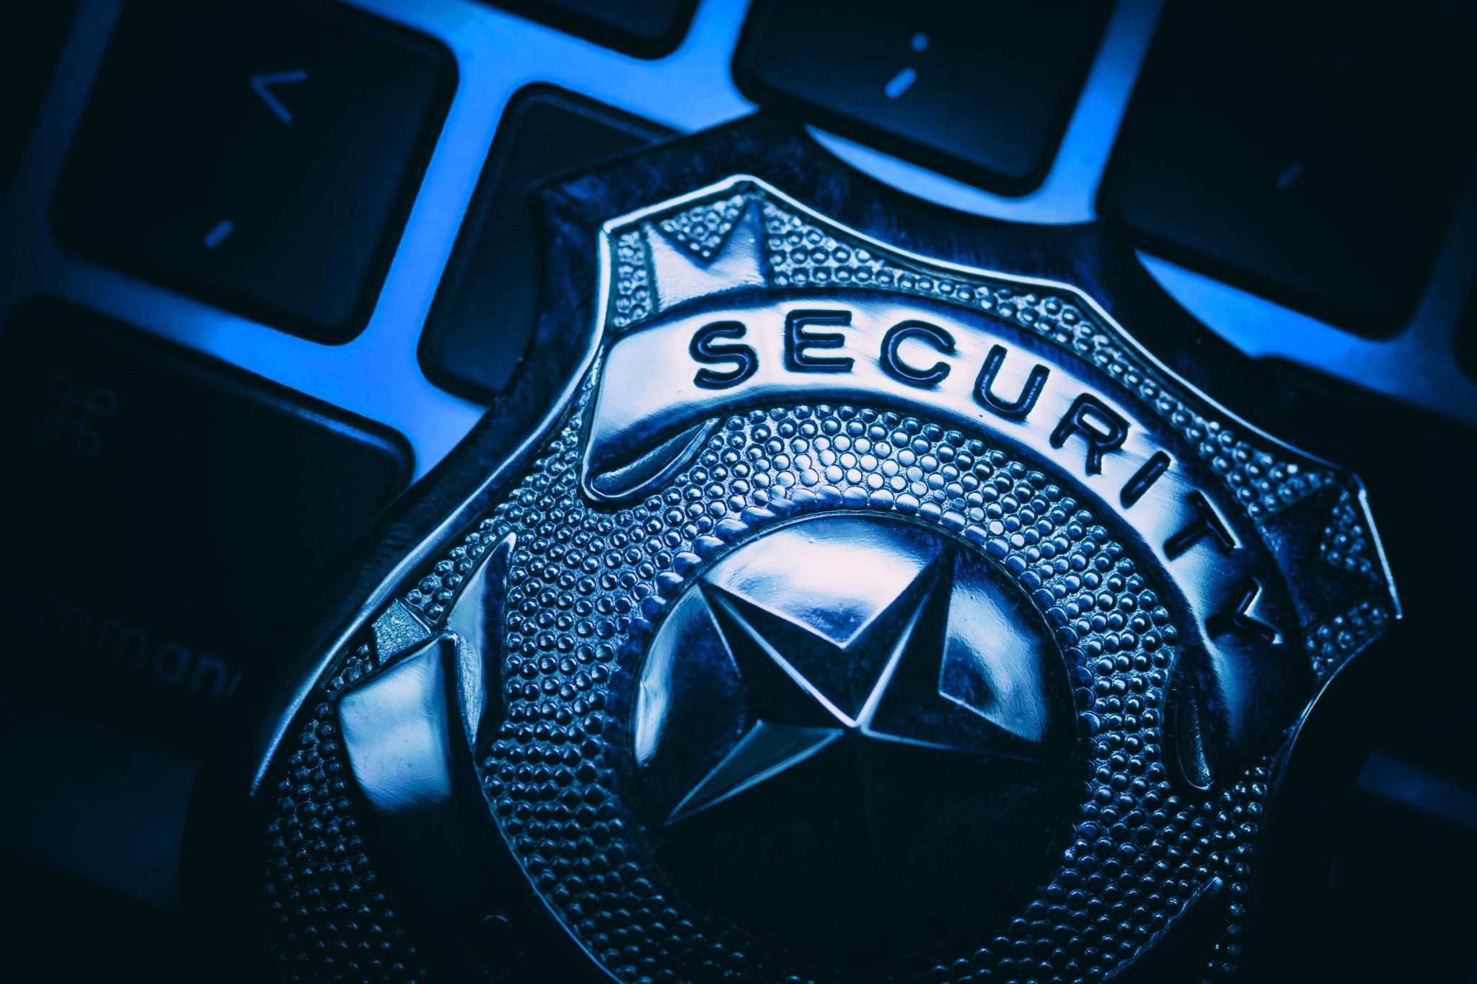
Protecting Premium House Lights: Understanding External Reconnaissance
Investigating the Extortion Threat
By: Harpreet Singh Sahi
Notes:
Good morning, everyone. My name is Harpreet Singh Sahi. We're here today to discuss the recent security threat against Premium House Lights and how we're investigating it. We will focus on 'external reconnaissance,' a key part of understanding this attack.

Slide 2
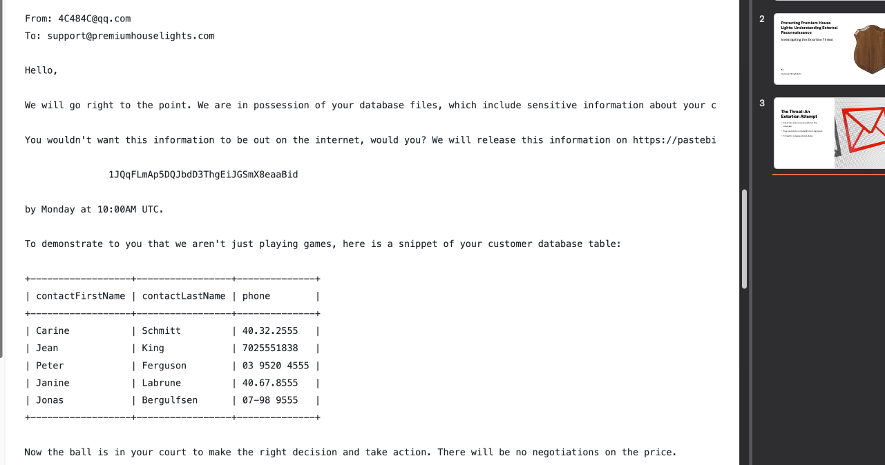
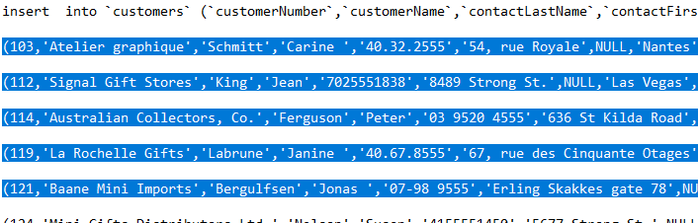
The Threat: An Extortion Attempt
Extortion email received from the attacker.
Key elements include Bitcoin demand.
Threat to release stolen data.
Figure 1 – Data from extortion email
Figure 2 – Customer Data from the server
Notes:
Let's start with the email that Premium House Lights received. As you can see, the sender claims to have our customer database and is demanding Bitcoin. To prove they're serious, they included a sample of what appears to be real customer data, and we double-checked the information with our database server. This is a classic extortion attempt, and we must take it seriously

Slide 3
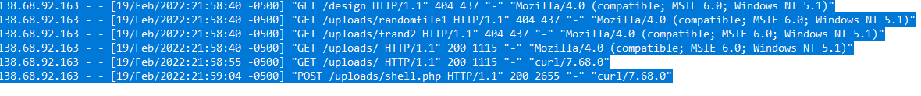
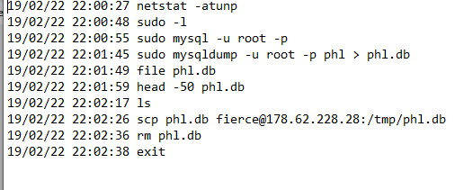
What is Reconnaissance?
Reconnaissance is like homework for attackers.
Imagine a thief checking a house before breaking in.
Attackers gather information without direct access.
MITRE ATT&CK framework TA0043
Figure 3 – Access log
Figure 4 – Database shell
Notes:
Reconnaissance is similar to an attacker preparing for an assault. It’s like a thief evaluating a house for vulnerabilities before breaking in. They look for weaknesses, such as unlocked doors or windows, and assess if anyone is present. In our discussion, we will emphasize the importance of external reconnaissance, focusing on what attackers can discover without physically entering our systems.
Attackers use Techniques under the Reconnaissance (TA0043) tactic as per the MITRE ATT&CK framework. Attackers did an Active Scan of the website, as shown in Figure 3. They kept getting a 404—access denied error, but they finally succeeded with a 200 code and uploaded the shell.php server file. As Evelyn mentioned earlier. Right after that, in Figure 4, attackers run commands in the server, gain access as root (just like admin access) easily without entering any password, and copy the whole data into their own database

Slide 4


Why This Matters
Understanding attackers' information gathering methods is essential.
Identifying vulnerabilities helps prevent future attacks.
Crucial for incident response and prevention strategies.
Notes:
Understanding how attackers gather information is crucial for our security posture. By identifying their methods, we can pinpoint vulnerabilities within our systems and develop strategies to mitigate future attacks. This knowledge is not only essential for incident response but also for crafting effective prevention strategies. The insights gained here will empower us to enhance our overall security framework. ______

Slide 5
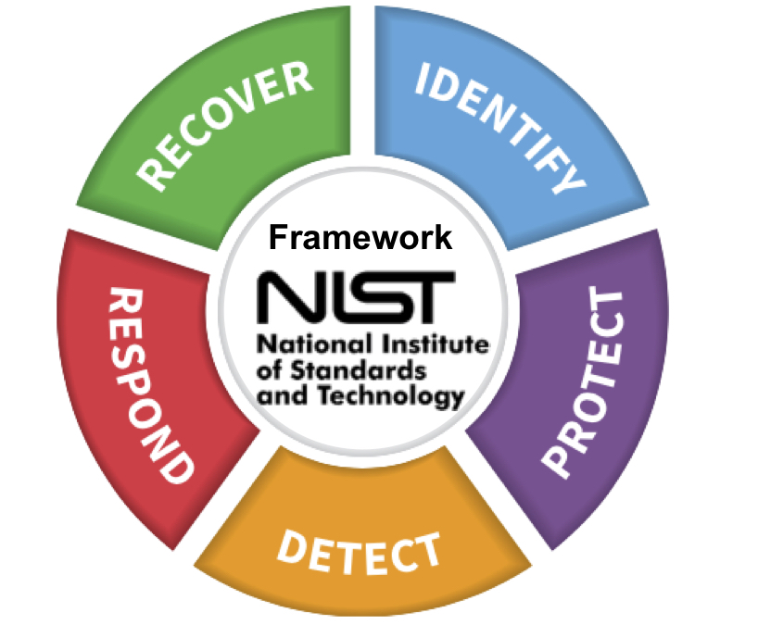
Our Next Steps Strategic Recommendations: Disrupting Reconnaissance
Adopt the NIST Cybersecurity Framework for guidance.
Focus on the Identify and Protect functions to enhance security.
Conduct Regular Risk Assessments to identify vulnerabilities. (CA-1)
Implement Security Awareness Training and Access Control. (AT-1)
Continuous Monitoring and Audits (CA-7)
Notes:
To disrupt reconnaissance efforts, we recommend adopting the NIST Cybersecurity Framework. We can significantly enhance our security measures by focusing on the Identify and Protect functions. Regular risk assessments will help us uncover vulnerabilities, while security awareness training and access control will empower our team. Continuous monitoring and audits are also vital to ensure we stay ahead of potential threats. These strategic recommendations will fortify our defenses against reconnaissance.

Slide 6

Questions & Answers
Open the floor for audience questions.
Encourage participants to ask about any topic covered.
Provide clear and thoughtful responses.
Thank everyone for their insights and queries.
Notes:
This concludes my presentation. I'm now happy to answer any questions you may have. Your inquiries are important, and I encourage you to ask about any aspects of the presentation or any other concerns you may have.

